Slide 1
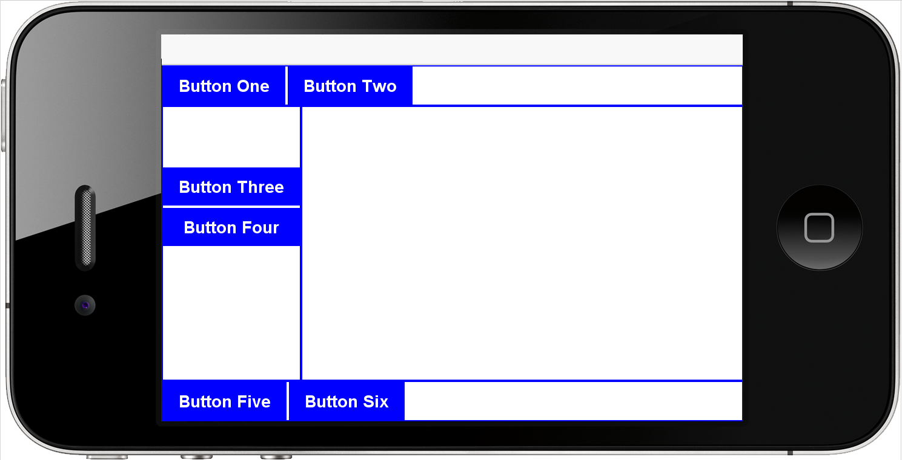


Drawing Coordinates (cont.)
Screen origin
(0,0)
Component origin (upper left corner of the container)
getY()
We draw on this container (it is the component we are interested in)
Parent’s origin
(upper left corner of the content pane of the form)
getX()
200
```
100
So to draw a rectangle at 100 pixels right and 200 pixels down of the origin of the component:
drawRect(getX()+100, getY()+200, width, height)

Slide 2
Pointer Graphics (cont.)
Screen origin
(0,0)
getAbsoluteY()of parent (content pane)
We draw on this container (it is the component we are interested in)
Parent’s origin
(upper left corner of the content pane of the form)
getAbsoluteX() of parent (content pane) is 0 in this example…

Slide 3
Defining “Selectability”
/** This interface defines the services (methods) provided
* by an object which is “Selectable” on the screen
*/
public interface ISelectable {
// a way to mark an object as “selected” or not
public void setSelected(boolean yesNo);
// a way to test whether an object is selected
public boolean isSelected();
// a way to determine if a pointer is “in” an object
// pPtrRelPrnt is pointer position relative to the parent origin
// pCmpRelPrnt is the component position relative to the parent origin
public boolean contains(Point pPtrRelPrnt, Point pCmpRelPrnt);
// a way to “draw” the object that knows about drawing
// different ways depending on “isSelected”
public void draw(Graphics g, Point pCmpRelPrnt);
}

